Slide 1
Report out: Olympic athlete stats

Slide 2
About
This is project Alma. Objective of this project is to find the insight from 120 years of Olympics data, which could be patterns/trends highlighting certain groups/events/countries, etc. for the purpose of developing a news story or discovering key health insights. Main target audience of this project would be elite personal trainers and news company. Our main tool would be Jupyter notebook

Slide 3
Content
Hypothesis & approach
Entity Relationship Diagram (ERD)
Initial Finding
Deeper Analysis
Hypothesis result

Slide 4
Section 1: Hypothesis & approach
Hypothesis 1: There is a relationship between athlete's age and the medal they gained. Maybe younger athlete had higher chance of getting prize than those who were older
Approach: Visualize data of age and medal count to find any existing relationship
Hypothesis 2: Some countries have greater advantage than other in specific season, and that's not the same between summer and winter. Maybe countries in colder area around the year would be more comfortable to compete in winter?
Approach: Sort out 5 best countries in term of medal number, compare between summer and winter

Slide 5
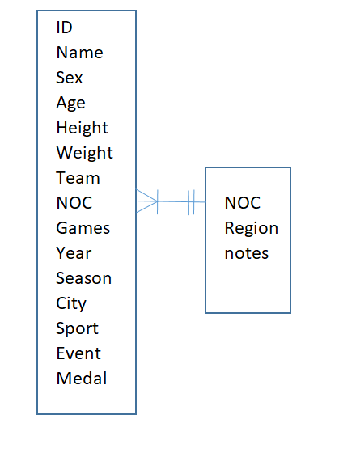
Section 2: ERD

Slide 6
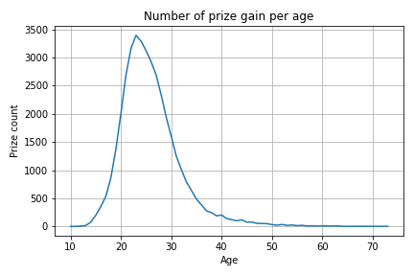
Section 3: Initial Finding
There is a relationship between age and probability of gain the prize, as prime age is around 23-24

Slide 7
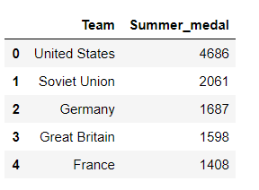
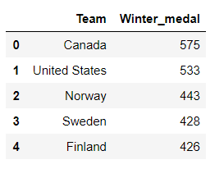
Section 3(con’t)
Top 5 countries in Summer are different from those in Winter, except for USA

Slide 8
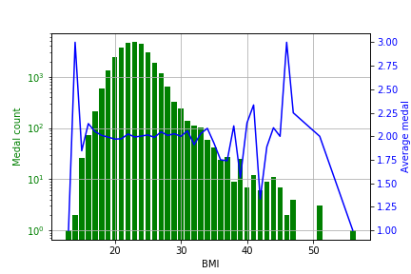
Section 4: Deeper Analysis
By creating new metric – BMI and medal_in_number, we can see that although BMI and medal rank does not have relationships, the best BMI for an athlete is around 20 - 22:

Slide 9
Section 5: Hypothesis Result
Hypothesis 1 result: True, there is a relationship between age and probability of gain the prize, as prime age is around 23-24
Hypothesis 2 result: True, different countries have advantage in Summer and Winter
Additional hypothesis result: False, there aren’t any relationship between BMI and medal ranking. However, best BMI for athlete would be around 20 - 22

